Slide 1
Assignment No. 3
Write a program to design student registration form by using HTML, CSS & JavaScript and perform following validations:
1) All fields mandatory,
2) Phone number validation,
3) Email address validation

Slide 2
Simple HTML File
<!DOCTYPE html>
<html>
<head>
<title>Page Title</title>
</head>
<body>
<h1>This is a Heading</h1>
<p>This is a paragraph.</p>
</body>
</html>

Slide 3
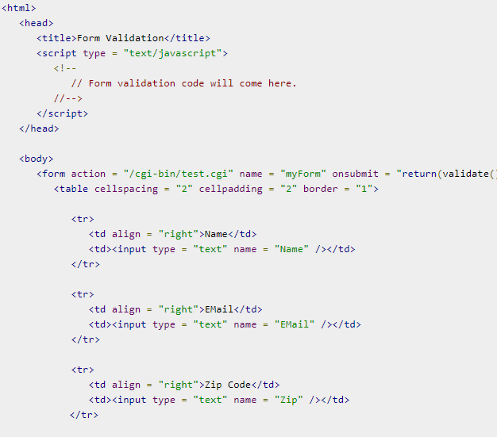
Design a form in html

Slide 4
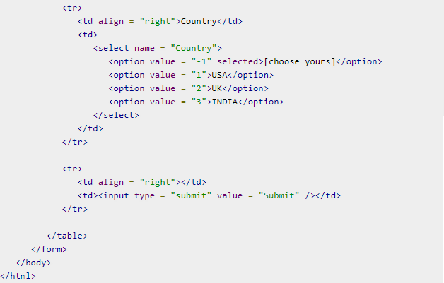
Continued..

Slide 5
JavaScript
Javascript is the most popular programming language in the world.
Javascript, helps developing great front-end as well as back-end softwares using different Javascript based frameworks like jQuery, Node.JS etc.
JavaScript usage has now extended to mobile app development, desktop app development, and game development.
This opens many opportunities for you as Javascript Programmer.

Slide 6
JavaScript
Form validation normally used to occur at the server, after the client had entered all the necessary data and then pressed the Submit button. If the data entered by a client was incorrect or was simply missing, the server would have to send all the data back to the client and request that the form be resubmitted with correct information. This was really a lengthy process which used to put a lot of burden on the server.
JavaScript provides a way to validate form's data on the client's computer before sending it to the web server. Form validation generally performs two functions.
Basic Validation − First of all, the form must be checked to make sure all the mandatory fields are filled in. It would require just a loop through each field in the form and check for data.
Data Format Validation − Secondly, the data that is entered must be checked for correct form and value. Your code must include appropriate logic to test correctness of data.

Slide 7
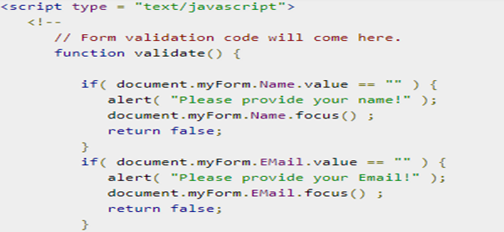
Basic Form Validation
In the above form, we are calling validate() to validate data when onsubmit event is occurring. The following code shows the implementation of this validate() function.

Slide 8
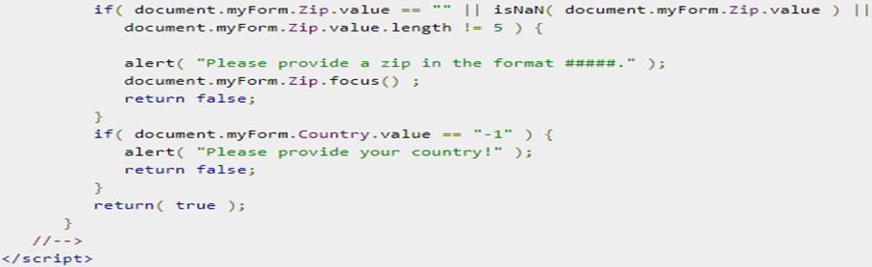
Continued..

Slide 9
Data Format Validation
We can validate our entered form data before submitting it to the web server.
The following example shows how to validate an entered email address. An email address must contain at least a ‘@’ sign and a dot (.). Also, the ‘@’ must not be the first character of the email address, and the last dot must at least be one character after the ‘@’ sign.
var emailID = document.myForm.EMail.value;
atpos = emailID.indexOf("@");
dotpos = emailID.lastIndexOf(".");
if (atpos < 1 || ( dotpos - atpos < 2 ))
{
alert("Please enter correct email ID")
document.myForm.EMail.focus() ;
return false;
}

Slide 10
Data Format Validation
Another way to validate Email Address
if(/^\w+([\.-]?\w+)*@\w+([\.-]?\w+)*(\.\w{2,3})+$/.test(document.myForm.email.value))
{
return (true);
}
alert("You have entered an invalid email address!")
return (false);
}

Slide 11
Continued..
Contact Number validation/ Zip code validation
if(isNaN(phno))
{
alert("Enter a valid mobile number");
document.myform.phno.focus();
return false;
}
if(phno.length!=10)
{
alert("Enter a 10 digit mo no");
document.myform.phno.focus();
return false;
}

Slide 12
Continued..
All letters Validation
var letters=/^[A-Za-z]+$/;
if(document.myForm.value.match(letters))
{
return(true);
}
else
{
alert("Please enter only letters");
document.myForm.Name.focus() ;
return false;
}

Slide 13
Continued..
All Numbers Validation
var letters=/^[0-9]+$/;
if(document.myForm.value.match(letters))
{
return(true);
}
else
{
alert("Please enter only letters");
document.myForm.Name.focus() ;
return false;
}

